Slide 1


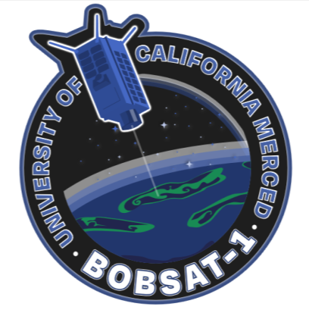
BOBSAT-1 Bio-optical Observations of Basins via
Spectral Analysis Technology-1
07/18/2025
UNP Final Presentation, Albuquerque NM
By:
UNP Team: David Hoehler, Kevin Moreno-Ruiz, & Zander Abid
Supported by CITRIS Team: Jamie Rose, Geovanny Lopez, Susana Gamino, Amy Peetaneelapalin, William Saldana
1
Notes:
Zander

Slide 2
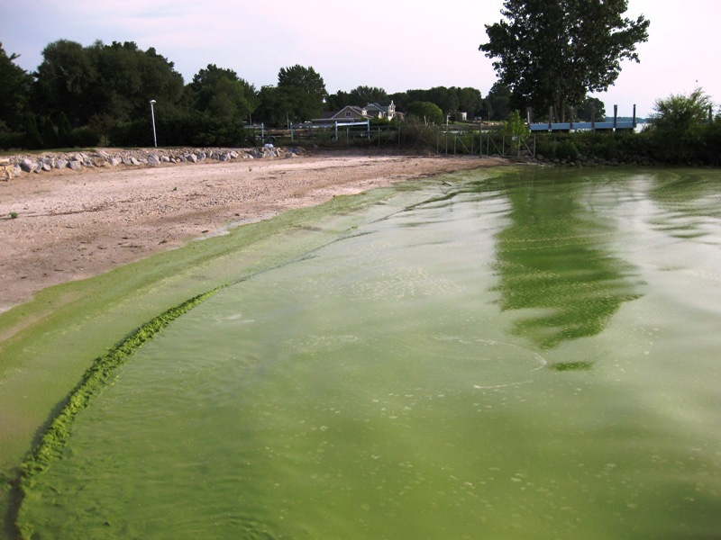
Mission Overview
Harmful Algal Blooms (HABs) remain a significant threat to the safety of living beings. The harmful aspect of the HABs are the cyanobacteria into fresh bodies of water, which releasing a group of toxins known as cyanotoxins. These toxins contaminate drinking water affecting human health, economy, and ecosystem negatively. Despite these risks, only 37-50 out of ~27,000 lakes and reservoirs across all of California are monitored regularly. Without broader monitoring, communities remain vulnerable to undetected blooms, delayed responses, and avoidable ecological and economic damage
Source: https://en.wikipedia.org/wiki/Harmful_algal_bloom

Slide 3
Gaps in Current Technologies
High operational costs:​
​People
Labs
Boats
Equipment
​
Delayed results:​
Ground sampling is time-consuming and cannot provide real-time or near-real-time data.​
Reactive approach: ​
Monitoring is typically initiated only after reported signs of a bloom, reducing early detection and response capabilities.​
Satellite Measurements:​
Lack the proper Ground Sampling Distance (GSD) and targets to measure inland bodies of water​
Lack of spectral fingerprints

Slide 4
Relevancy
NASA
Decadal Survey
Ecosystem Change.
Reducing Climate Uncertainty and Informing Societal Response.
Surface Dynamics, Geological Hazards and Disasters.
DoD
First University to do 3U Hyperspectral imager
Hyper Spectral Imaging with other bands
Preliminary studies indicate manipulatable bands may be selected

Slide 5
Mission Statements
[Initial]
BOBSat-1 is a 3U CubeSat designed to monitor harmful algal blooms (HABs) across California. Equipped with a hyperspectral camera, it will collect high-resolution data from remote and under-monitored water bodies, improving detection and analysis of potential bloom activity.
[Final]
BOBSAT-1 shall detect potentially harmful algal blooms (PHABs) in inland water bodies across California for public interests.

Slide 6
Mission Objective(s)
[Initial]
Image with a spectral range of 400-900nm to detect HABs
Image with a spectral resolution of ±5 or less
Point within meters
Image with 18m (stretch) 30m (ideal) 60m (minimum) resolution
[Final]
Measure reflectivity of bodies of water at wavelengths associated with algal bloom pigments to characterize potentially harmful algal blooms (PHABs).

Slide 7
Mission Criteria
Minimum Success Criteria:
Take an image of the entire area of a target lake
Determine the presence of potentially harmful algal blooms
Full Success criteria:
Quantify the size and density of potentially harmful algal blooms
Downlink data within 2 days of imaging

Slide 8
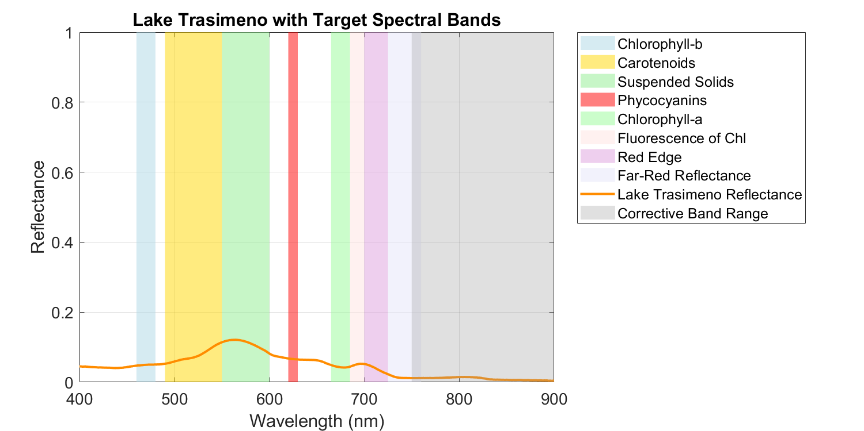
Spectral Bands
Spectral bands used to characterize potentially harmful algal blooms (PHABs) in fresh-water bodies
Chlorophyll-a
Chlorophyll-b
Suspended solids
Phycocyanin
Red-edge
Far red reflectance
Ground-based reflectance data shown to illustrate target spectral bands relevant to BOBSAT-1’s detection strategy.

Slide 9
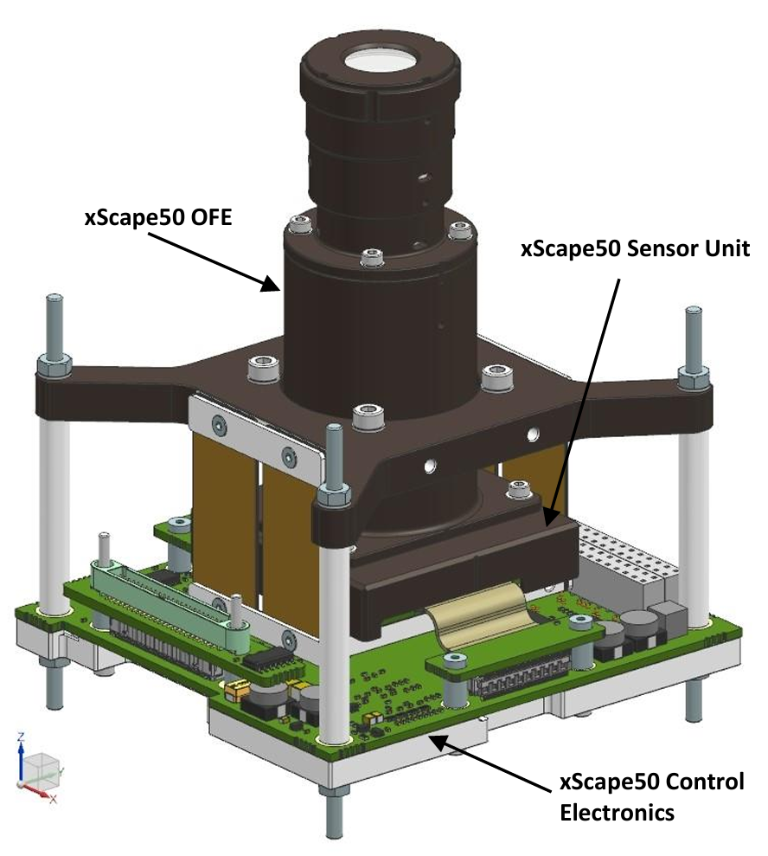
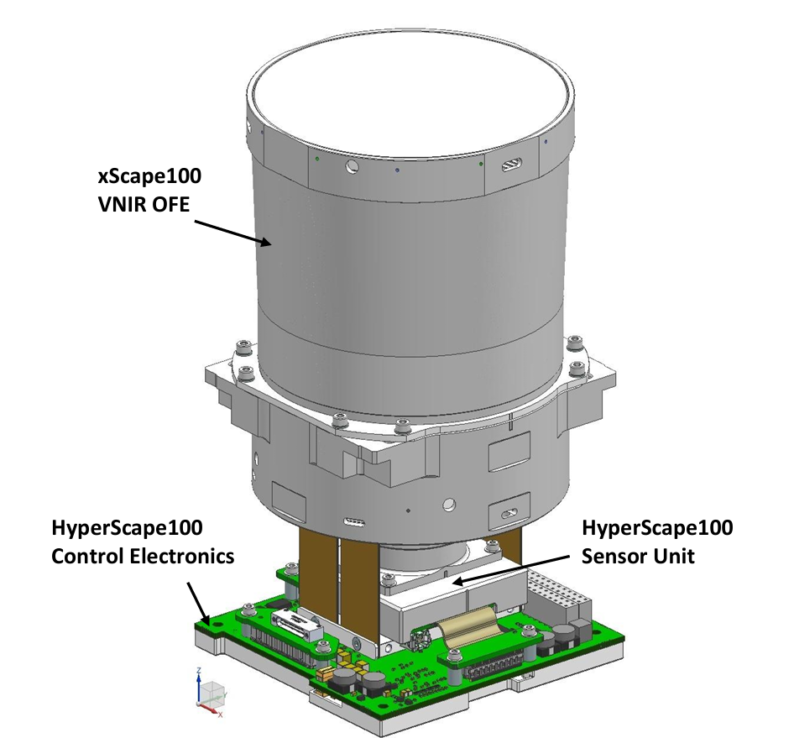
Payload Overview
Commercial-off-the-shelf (COTS) trade study of 20 imagers
Mission relevant considerations:
Spectral range, ground sampling distance (GSD), and volume (cost-impact)
HyperScape 50 (HS50) is most compatible with mission design considerations:
HyperScape 100 (HS100) would give a better GSD making more lakes resolvable but swath width lacks.
Payload​ | Spectral Range​ | Spectral Bands​ | GSD @500 km​ | Swath Width @ 500 km ​ | Volume (U)​
HyperScape 50​ | 460-860​ | 32 user defined​ | 30 m​ | 120​ | 1U​
HyperScape 100​ | 460-860​ | 32 user defined​ | 4.75 m​ | 19.4​ | 1.5​
MultiScape 50 ​ | 460-860​ ​ | 8 bands manufacturer defined | 30 m​ | 120​ | 1U​
MultiScape 100​ | 460-860​ | 8 bands manufacturer defined | 4.75 m ​ | 19.4​ | 1.5U​
HyperScape 50
HyperScape 100

Slide 10
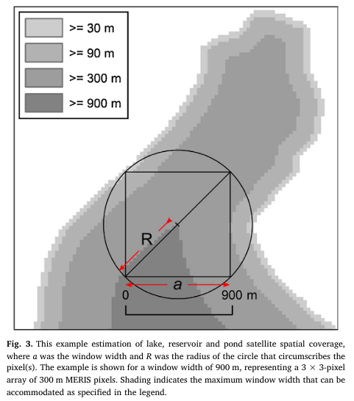
Viable Data for Analysis
Water-only pixels are viable for analysis.
3×3 array minimum will reduce mixed-pixel error (Clark et al., 2017).
The array helps reduce contamination from land-signals.
Minimum distance from shore needed to fully enclose a square pixel array is given by:
R=a (√2)/2
Lakes too narrow to fit array are marked as less resolvable.
This method will be used to define minimum lakes that are imageable
Clark et al., 2017, Ecological Indicators doi: 10.1016/j.ecolind.2017.04.046

Slide 11
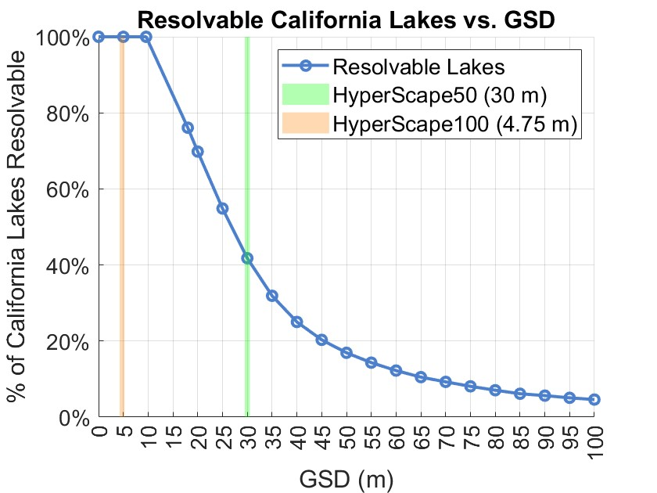
GSD vs Resolvable Lakes
There are ~18,000 California fresh water bodies.
GSD is crucial to what lakes we can image
At 30 m GSD (HS50), ~42% of lakes are resolvable.
At 4.75 m GSD (HS100), 100% of waterbodies are resolvable.
This captures theoretical potential of each sensor based on GSD alone.
Source: USGS National Hydrography Dataset (NHD) – High Resolution HU4 Shapefiles. Accessed from https://prdtnm.s3.amazonaws.com/index.html?prefix=StagedProducts/Hydrography/NHD/HU4/Shape/

Slide 12
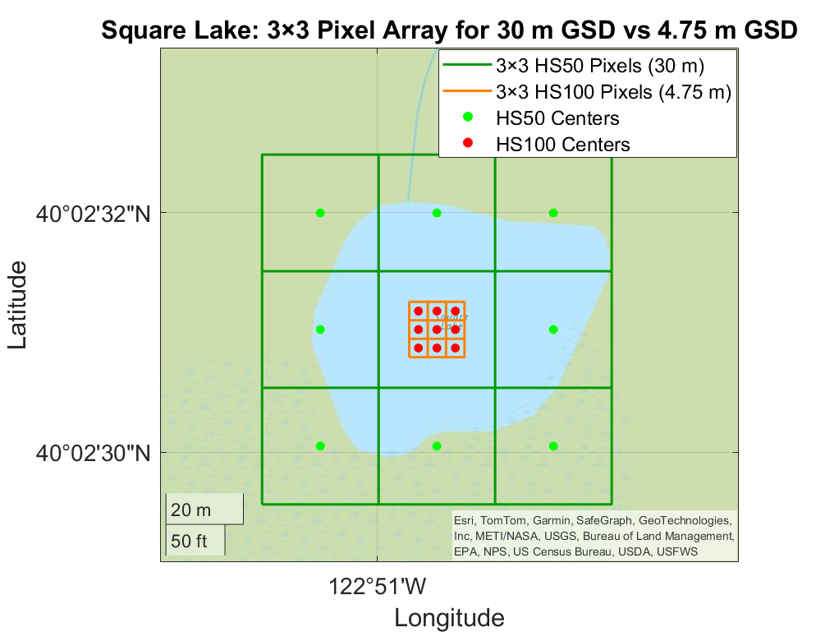
GSD Pixel Array
Plotted is one of California's smallest water bodies
Square Lake (~60 m by 40 m in size)
Each individual box here is one pixel.
As stated previously, at least one array of fully water-only pixels is required for accurate analysis.
The visual compares the 3 x 3 arrays for 30 m GSD vs 4.75 m GSD.
Maximum imageable lake per payload.
HS 50 (HS50) ~90 m x 90 m
HS 100 (HS100) ~14.25 m x 14.25 m
Source: USGS National Hydrography Dataset (NHD) – High Resolution HU4 Shapefiles. Accessed from https://prdtnm.s3.amazonaws.com/index.html?prefix=StagedProducts/Hydrography/NHD/HU4/Shape/

Slide 13
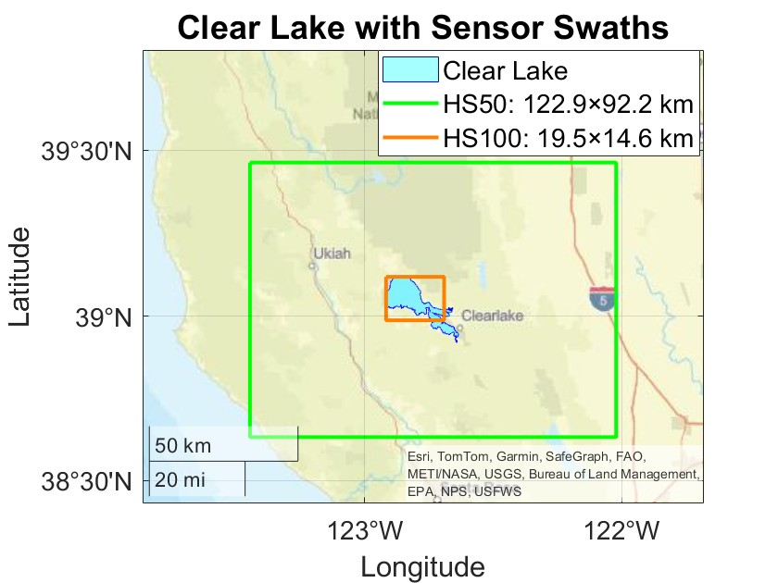
Sensor Swath Capability
Both HS50 and HS100 use a 4096 x 3072-pixel detector.
Swath width and length depend on GSD:
Width = 4096 x GSD
Length = 3072 x GSD
HS50 (GSD = 30 m)
Swath = 122.9 x 92.2 km
HS100 (GSD = 4.75 m)
Swath = 19.5 x 14.6 km
Clear Lake - freshwater body native to California.
Source: USGS National Hydrography Dataset (NHD) – High Resolution HU4 Shapefiles. Accessed from https://prd-tnm.s3.amazonaws.com/index.html?prefix=StagedProducts/Hydrography/NHD/HU4/Shape/

Slide 14
Experiment Plan
Hyperspectral images will be acquired over stakeholder defined inland waterbodies in California.
Imaging will occur when cloud-coverage permits and there is proper lighting conditions.
Data will be downlinked to ground stations and post-processed to extract:
Reflectance
Spectral Indices
Lake map
If there are multiple lakes images, experiment will be prioritized on public health impact.

Slide 15
Concept of Operations – Mission Phases
Launch and Early Orbit Phase (LEOP)
Detumble
Payload Calibration
14-28 days
Spectral calibration with RadCalNet
Experiment Cycle
Check state of health
7-28 days
Imaging
Data proccessing
Downlink
Standby (recharge)

Slide 16
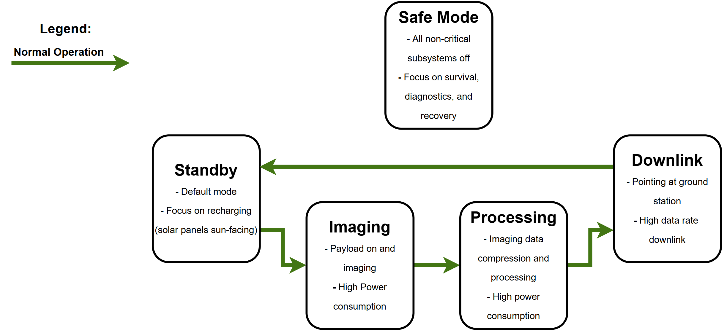
Concept of Operations - Modes

Slide 17
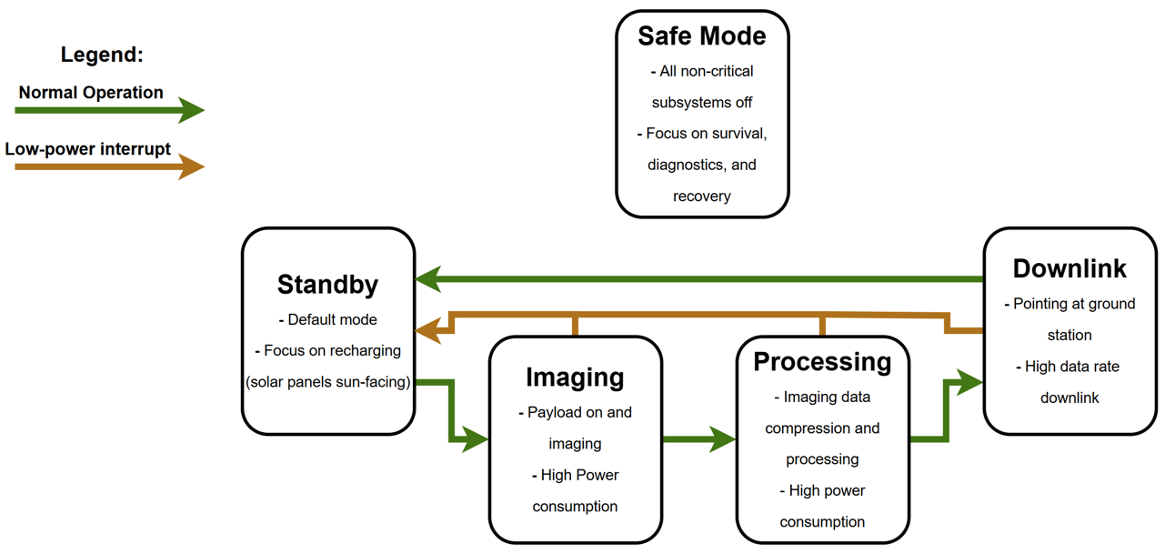
Concept of Operations - Modes

Slide 18
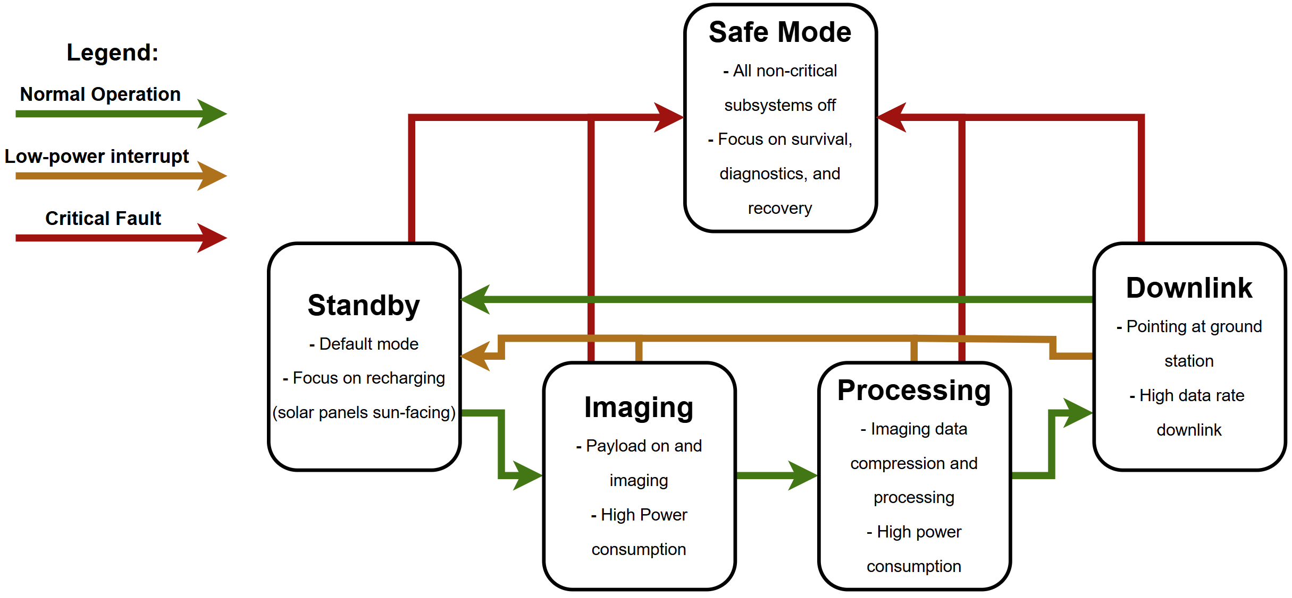
Concept of Operations - Modes

Slide 19
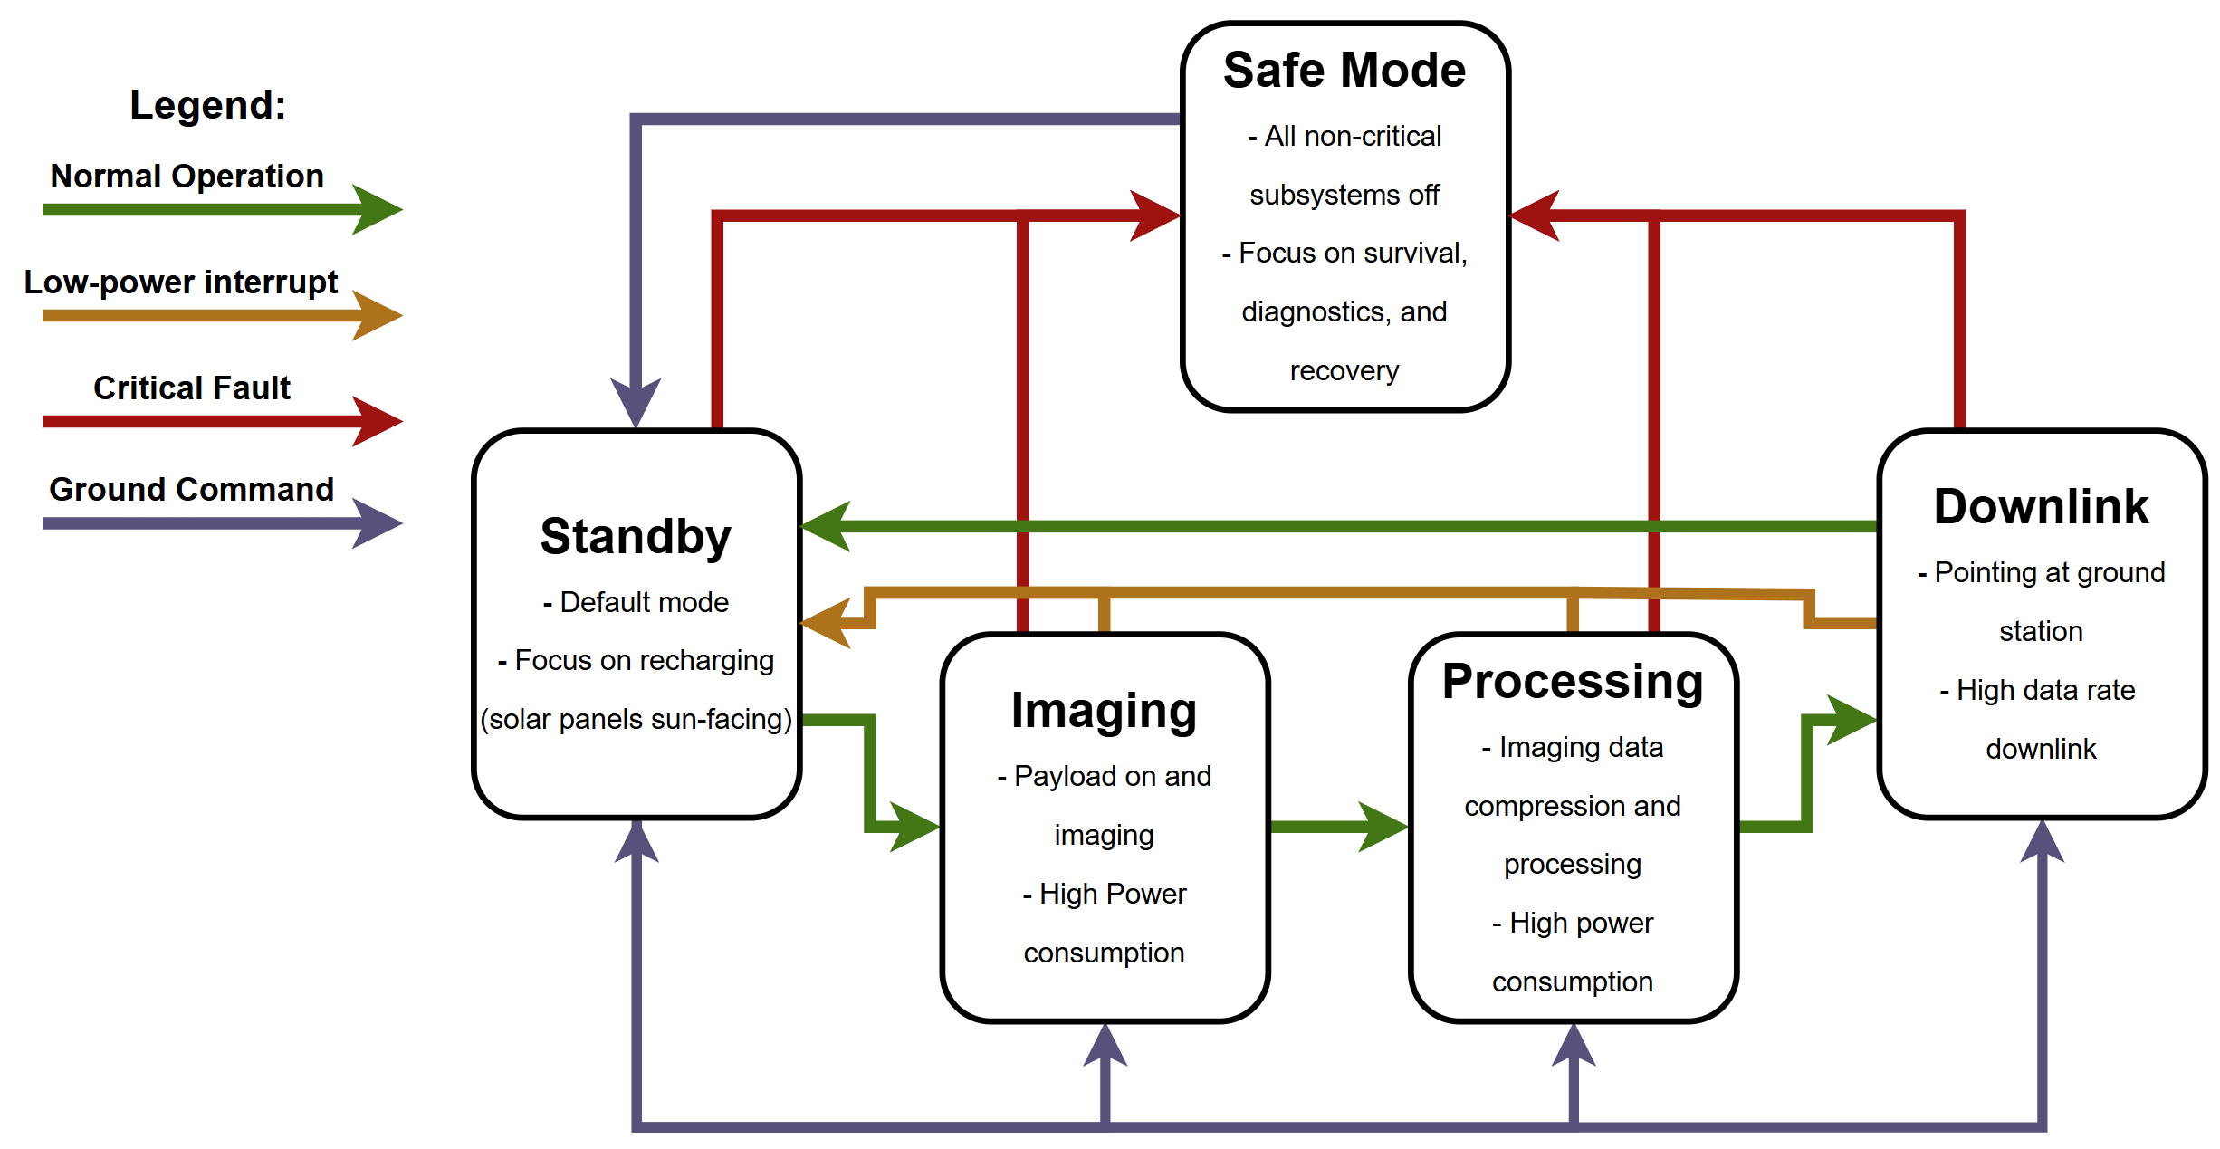
Concept of Operations - Modes

Slide 20
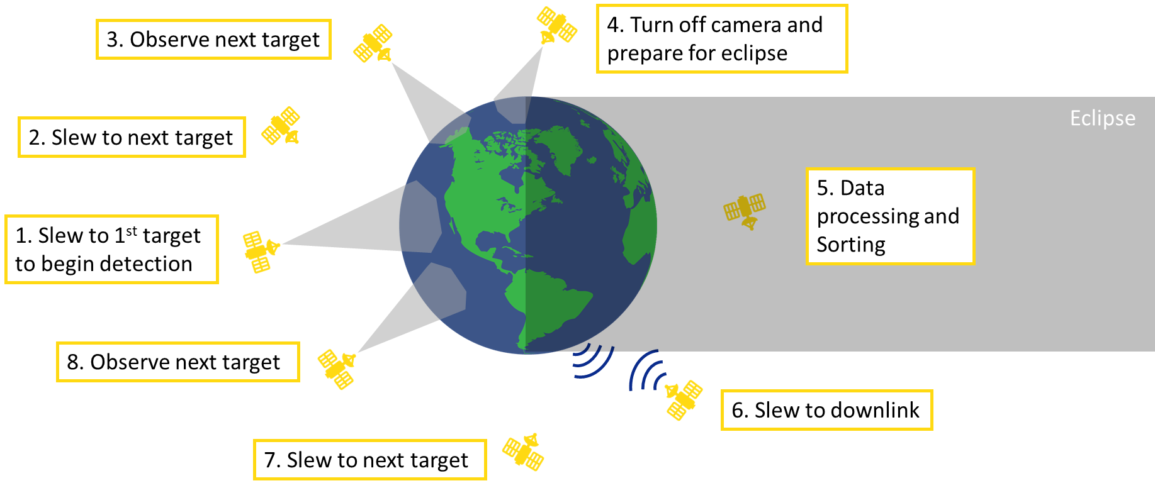
CONOPS Orbit Example
Source: UNP Mission Design Course Presentation

Slide 21
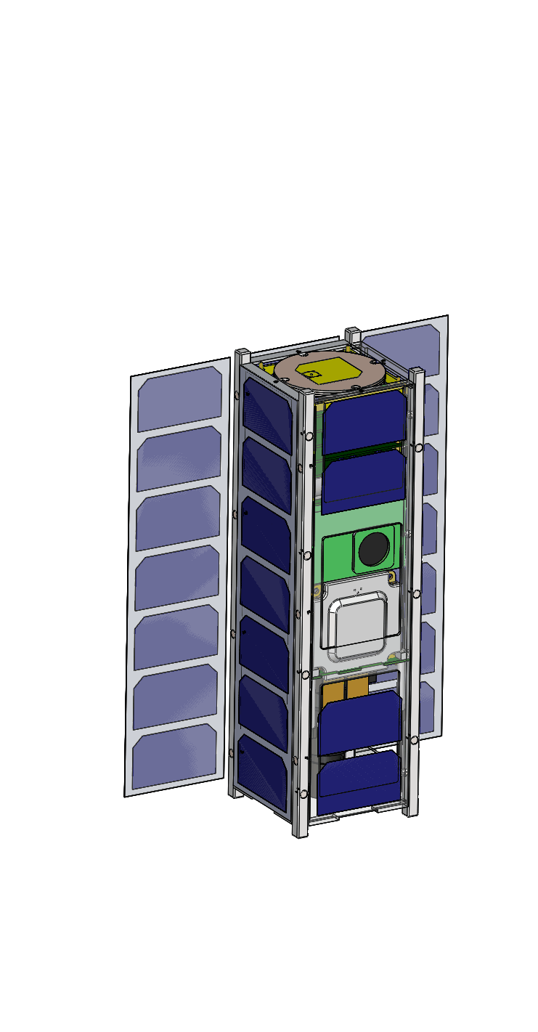
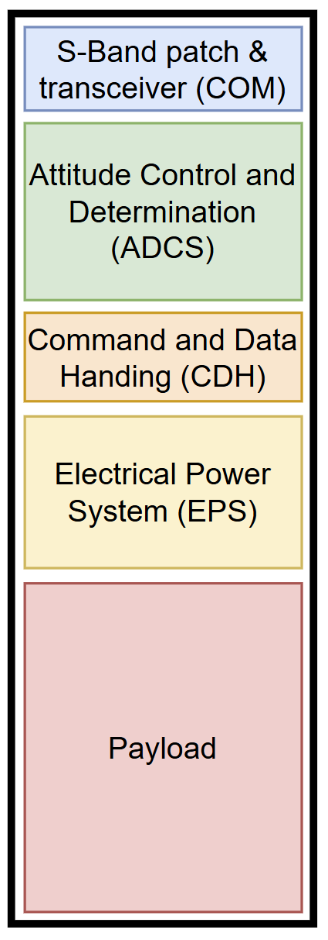
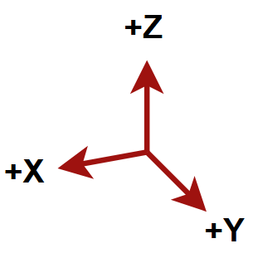
Spacecraft Layout
1U payload in 3U structure
24W deployable panels
S-band antenna on +Z
Payload facing -Z
Star tracker +Y
Thermal control in EPS and Payload section
ADCS placed for high control authority

Slide 22
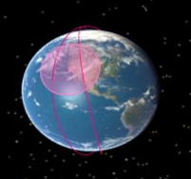
Assumption and Next Steps
Assumptions
All lakes currently have equal priority
Human health impacts
Economic impacts
Enviromental impacts
Algal bloom probability
Existing monitoring conditions
Orbit will allow for acceptable lighting parameters
Imaging > 30° solar zenith
Imaging < 50° solar zenith
Next Steps
Determine lake priorities
Conduct literature review
Analyse publicly available lake data
Establish working relationships with water body regulatory authorities
Conduct orbital analysis
Determine necessary orbital parameters

Slide 23
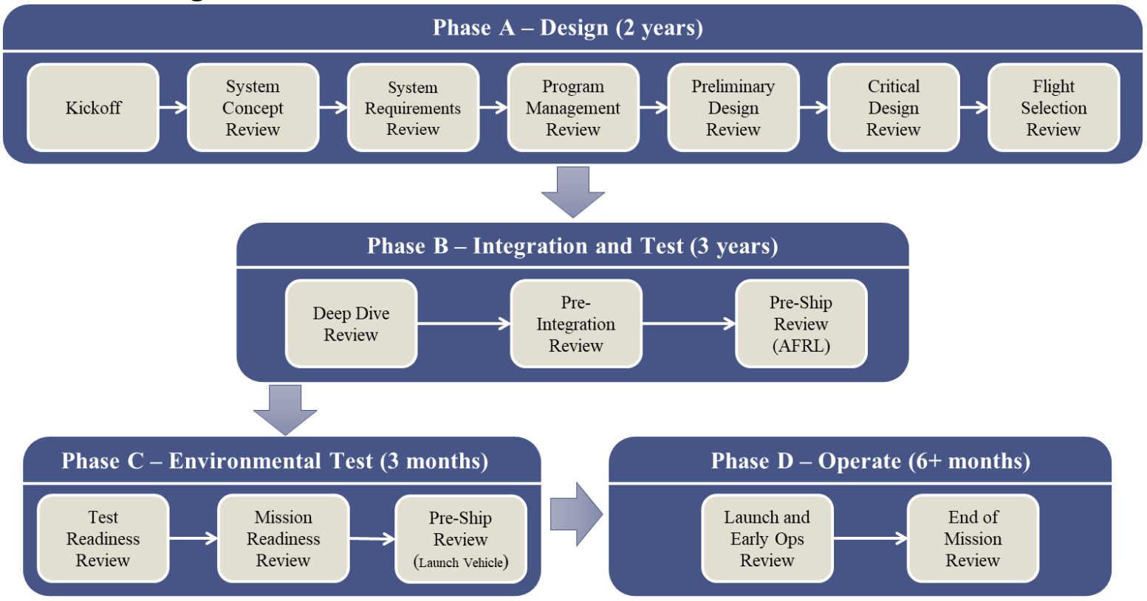
Misson Concept Impact
Provided development framework and team structure
Established deliverables
Refined mission definition
Science mission vs tech demo
Accelerated skill transfer between founding members and new team members
Advanced systems engineering skillsets
Source: UNP Nanosatellite User Guide

